Slide 1


SIMATS ENGINEERING
SAVEETHA INSTITUTE OF MEDICAL AND TECHNICAL SCIENCES
Adaptive Path Planning for Autonomous Warehouse Robots Using Deep Reinforcement Learning
MLA0304-Reinforcement Learning
Date : 08/09/2026
Guided by:
Dr. Dumpala Prasanth
Associate Professor
Presented by:
M. Nandhini-192472318
K. L. Khaviya varshini- 192472381

Slide 2
ABSTRACT
Focuses on adaptive path planning for autonomous warehouse robots.
Uses Deep Reinforcement Learning (DRL) for intelligent navigation.
Implements a Deep Q-Network (DQN) for action selection.
Considers robot position, destination, and surrounding obstacles.
Uses rewards and penalties to improve navigation decisions.
Uses Experience Replay and a Target Network for stable learning.
Aims to generate an efficient, adaptive, and collision-free p.

Slide 3


INTRODUCTION
Modern warehouses use Autonomous Mobile Robots (AMRs) to transport goods between storage, picking, and delivery areas.
Efficient path planning is essential to reduce travel distance, execution time, energy consumption, and collisions.
Traditional methods such as A*, Dijkstra, and rule-based navigation generally depend on predefined maps or manually designed strategies.
These methods can become less effective when the warehouse contains dynamic obstacles or changing layouts.
Deep Reinforcement Learning (DRL) enables a robot to learn navigation decisions through interaction with its environment.
The robot observes its current state, selects an action, receives a reward or penalty, and gradually learns an improved navigation policy.
The proposed system focuses on adaptive, collision-free, and efficient warehouse path planning using DQN-based DRL.

Slide 4
OBJECTIVES
To avoid static and dynamic obstacles during navigation.
To minimize path length and travel time.
To reduce the probability of robot-obstacle collisions.
To improve navigation performance when the warehouse environment changes.
To enable the robot to learn an efficient path from source to destination.
To compare the DRL approach with a traditional method such as A*.
To evaluate the system using success rate, path length, collision rate, and completion time.
To develop an adaptive warehouse robot path-planning system using Deep Reinforcement Learning.

Slide 5
PROBLEM STATEMENT
Warehouse robots require efficient and safe navigation to perform tasks.
Traditional path-planning methods may struggle in changing and obstacle-filled environments.
Inefficient paths can increase travel time and unnecessary movement.
Robot collisions with shelves or obstacles can affect safety and performance.
There is a need for an adaptive path-planning system that learns from environmental interaction.
The proposed system uses Deep Q-Network (DQN)-based Reinforcement Learning for intelligent navigation.
The goal is to generate an efficient, adaptive, and collision-free path for autonomous warehouse robots.

Slide 6
LITERATURE SURVEY
S.No | Title | Authors | Year | Techniques Used | Problem Addressed
1 | Deep Reinforcement Learning Based Mobile Robot Navigation: A Review | K. Zhu, T. Zhang | 2021 | DRL, DQN, Policy-based RL | Limitations of conventional navigation methods in complex environments
2 | Multi-Robot Path Planning Based on a Deep Reinforcement Learning DQN Algorithm | P. Yang et al. | 2020 | DQN, Q-Learning, Experience Replay | Efficient path planning and coordination of multiple warehouse robots
3 | A Review of Deep Reinforcement Learning Algorithms for Mobile Robot Path Planning | R. Singh, J. Ren, X. Lin | 2023 | DRL, DQN, Policy Gradient, Actor-Critic | Path planning in complex and dynamic environments
4 | Path Planning Techniques for Mobile Robots: Review and Prospect | L. Liu et al. | 2023 | A*, Heuristic, Global/Local Planning | Shortest, safe and time-efficient robot navigation
5 | Mobile Robot Navigation Based on Deep Reinforcement Learning: A Brief Review | H. Li | 2023 | DRL, Deep Neural Networks, RL | Adaptive navigation using learned policies instead of fixed rules

Slide 7
Module 1: Warehouse Environment & State Management
What it does
This module creates the warehouse environment and provides the information needed by the RL agent.
Process:
Creates a 2D warehouse environment containing the robot, destination, shelves, and obstacles.
Represents the robot's current state, including its position, target location, and nearby obstacles.
Defines the possible robot actions such as Up, Down, Left, Right, and Stop.
Detects collisions and destination arrival.
Provides the current state and feedback to the DQN agent.
Simple flow
Warehouse → Robot observes environment → State → DQN Agent

Slide 8
Module 2: DQN-Based Adaptive Path Planning
What it does
This is the main intelligence module. It trains the robot to learn the best navigation decisions.
Process:
Uses a Deep Q-Network (DQN) to estimate the value of possible robot actions.
Provides rewards for efficient movement and penalties for collisions or unnecessary movements.
Uses Experience Replay and Target Network to improve training stability.
Trains the robot through multiple episodes until it learns an effective navigation policy.
Generates an adaptive and collision-free path toward the destination.
Simple flow
State → DQN → Q-values → Best Action → Reward/Penalty → Learning → Improved Path

Slide 9
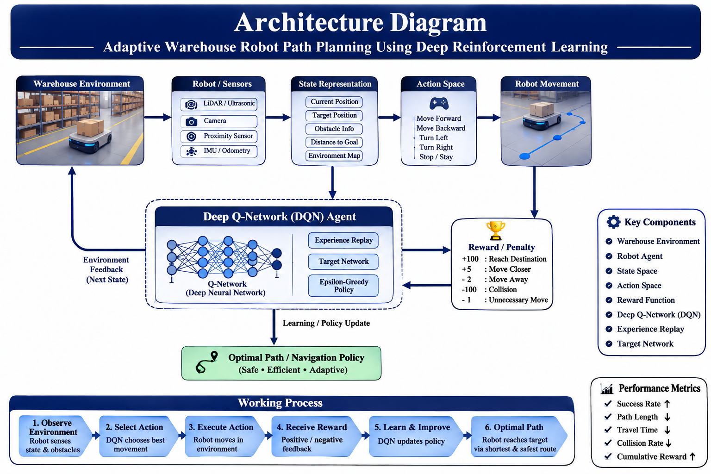
ARCHITECTURE DIAGRAM

Slide 10
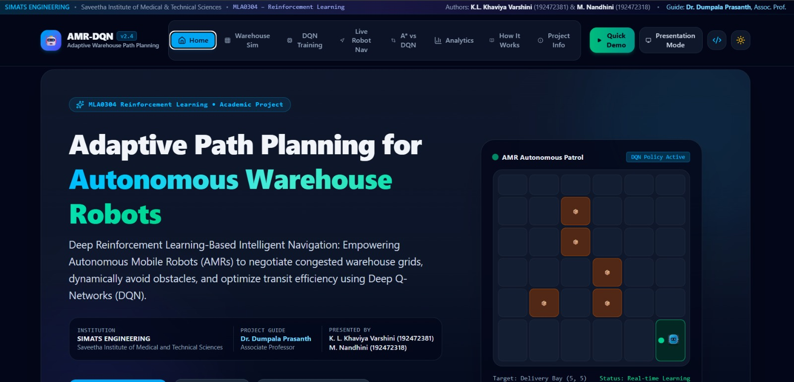
IMPLEMENTATION

Slide 11
CONCLUSION
The project proposes an adaptive warehouse robot path-planning system using Deep Reinforcement Learning.
A DQN agent learns to select appropriate movements based on the robot's current state.
The reward mechanism encourages the robot to reach its destination safely and efficiently.
Compared with conventional fixed path-planning methods, the proposed approach aims to provide better adaptability to changing environments.
Performance can be evaluated using success rate, path length, collision rate, completion time, and reward.
The system can be further extended to dynamic obstacles, multiple robots, real sensor data, and real-world robotic platforms.

Slide 12
FUTURE SCOPE
Extend the system to handle dynamic and moving obstacles.
Implement multi-robot coordination in warehouse environments.
Integrate real-time sensor data for better environmental awareness.
Deploy the system on a physical autonomous warehouse robot.
Apply advanced Deep Reinforcement Learning algorithms for improved performance.
Test the system in larger and more complex warehouse environments.
Add real-time monitoring and communication features for practical deployment

Slide 13
REFERENCES
Zhu, K., & Zhang, T. (2021). Deep Reinforcement Learning Based Mobile Robot Navigation: A Review. Tsinghua Science and Technology.
Yang, P. et al. (2020). Multi-Robot Path Planning Based on a Deep Reinforcement Learning DQN Algorithm. CAAI Transactions on Intelligence Technology.
Singh, R., Ren, J., & Lin, X. (2023). A Review of Deep Reinforcement Learning Algorithms for Mobile Robot Path Planning. Vehicles, 5(4), 1423–1451.
Liu, L. et al. (2023). Path Planning Techniques for Mobile Robots: Review and Prospect. Expert Systems with Applications, 227.
Li, H. (2023). Mobile Robot Navigation Based on Deep Reinforcement Learning: A Brief Review. Journal of Physics: Conference Series, 2649, 012027.

Slide 14
THANK YOU

